Slide 1
Unit 12
What did you do last weekend?
Section B 3a-Self Check
七年级下册

Slide 2

Objectives
To prepare students to write using the target language
To review and do more exercises to consolidate the key parts of this unit

Slide 3

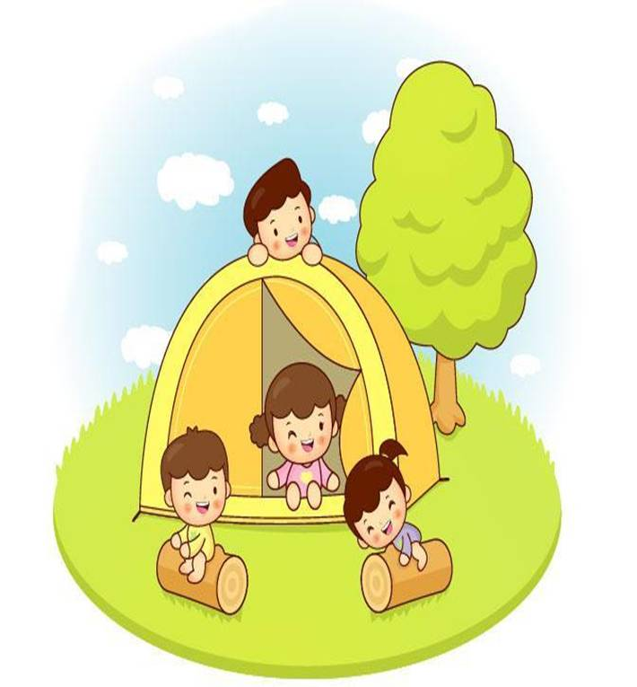
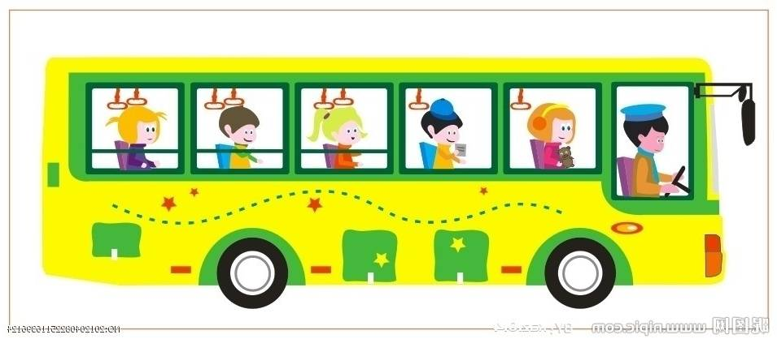



Slide 4
Lisa’s last weekend was interesting but scary.
They went camping in a small village in India.
First, they took a long bus ride to a lake in the countryside. There they put up their tents and made a fire to keep us warm and cook food.

Slide 5
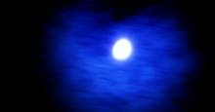
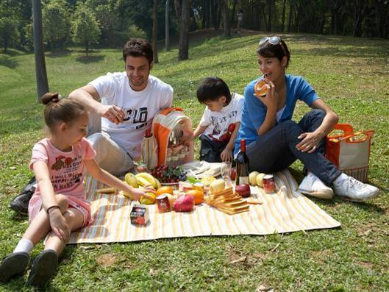
The first night, they just sat under the moon and told each stories. But Lisa was so tired that she went to sleep early.

Slide 6

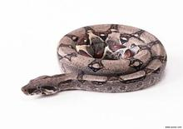
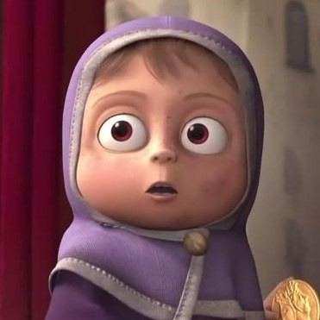
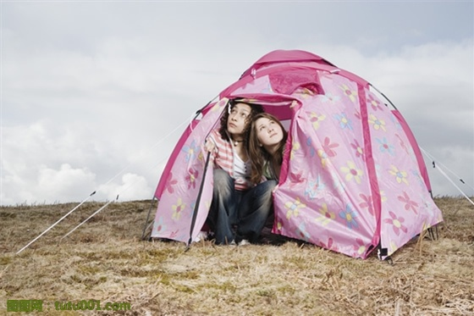
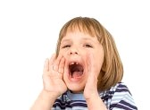
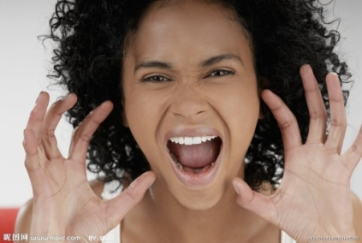
The next morning,
Lisa and her sister got a terrible surprise. When they looked out of the tent, they saw a big snake sleeping near the fire. She was so scared that she couldn’t move. They shouted to their parents to let them know about the danger.

Slide 7
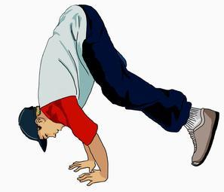
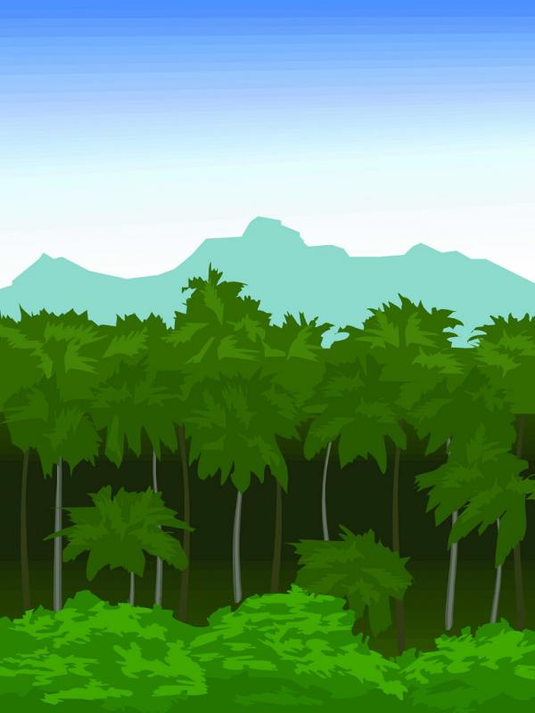
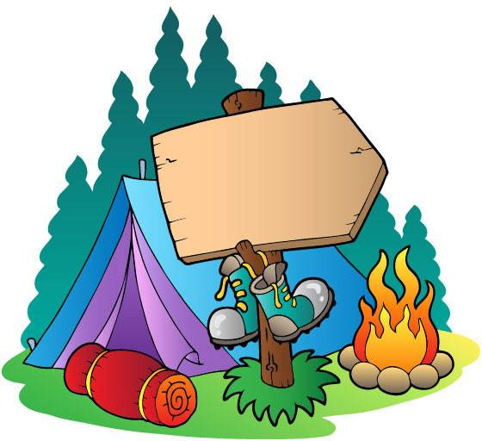
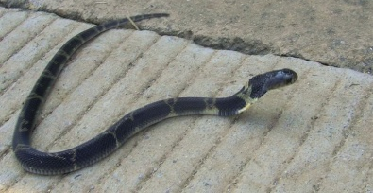
Her dad started to jump up and down in their tent. This woke the snake up and it moved into the forest near the lake.

Slide 8
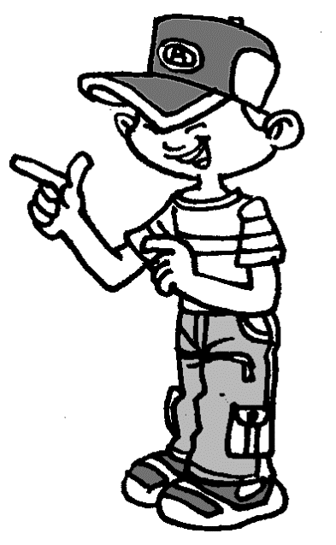

Her dad told her later that snakes don’t have ears but they can feel things moving. He also told her it was important not to go near a snake. This was a very useful lesson for her.

Slide 9
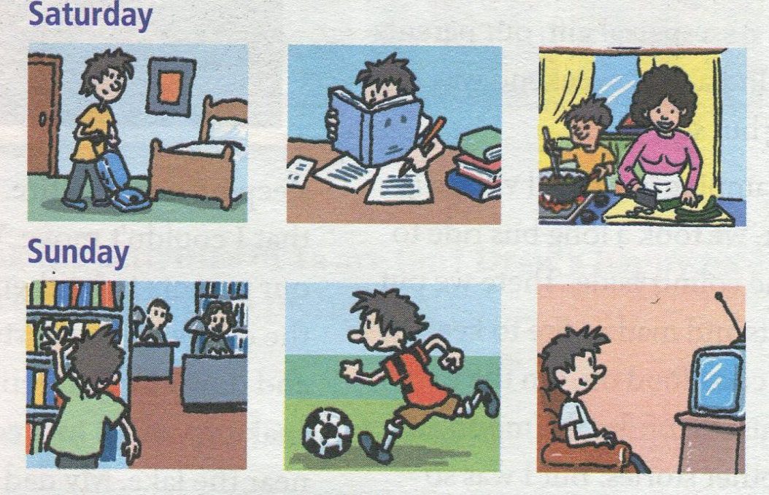
3a. Look at the picture and complete
the passage.

Slide 10
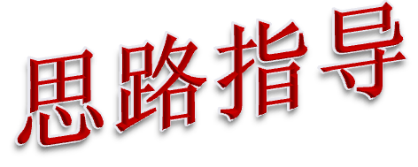
先看所给的图画，明确它们所表示的动作。
2. 通读全文，理解短文大意。
理解每句话的意思，根据图片所表示 的动作及上下文的暗示来确定空格的意思。第一图画表示打扫房间，在短文中做了文字描述；

Slide 11
第二图表示在做作业，应在第二空格处填；第三图显示“妈妈在做饭”，但本句主语是“I”，可推知空格处意为“帮助妈妈”；第四图显示他在图书馆里，可推知第三空格处应填“去了图书馆”；第四、五空格分别为踢足球和看电视。

Slide 12
I had a busy weekend. On Saturday morning,
I _______________. In the afternoon, I ______
_________ . It was a little difficult. On Saturday night, I stayed at home and
______________ cook dinner. On Sunday morning, I ________________.I read a book about history. Then in the afternoon, I ____________ with my friends. On Sunday night, I ___________. I saw an interesting talk show.
cleaned my room
did (my)
homework
helped my mom
went to the library
played soccer
watched TV

Slide 13
3b. Write about what you did last
weekend.
_________________________________________
__________________________________________
__________________________________________
__________________________________________
__________________________________________

Slide 14
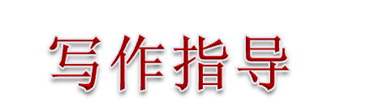
1. 这是一篇介绍自己在周末两天所做的事情，因此应用第一人称，用一般过去时态来写作。
首先，应表述自己对周末的总体感受；

Slide 15
3. 然后，可以回想一下自己分别在周六上午、下午和晚上分别做过什么事情；然后，再回想，在周日的上午、下午、晚上分别做了什么事情。然后，将这些事情连在一起，形成一遍连贯的短文。
4. 最后，还要再通读一遍短文，再重点看一下动词的一般过去式有没有搞错。看句子是否通顺。

Slide 16

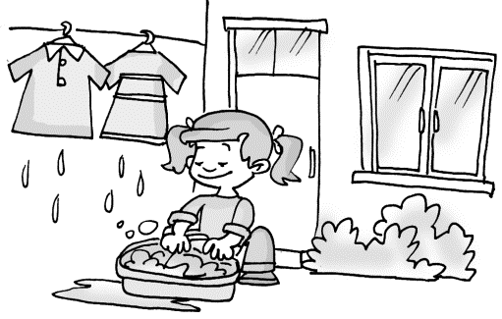
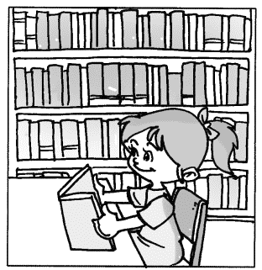
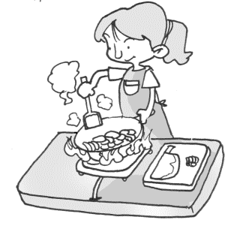
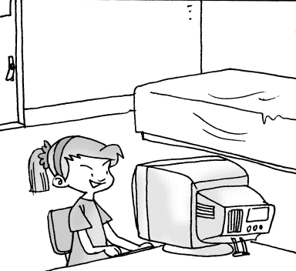
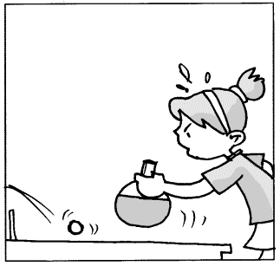
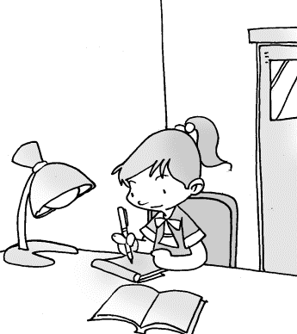
On Saturday morning, I …
On Saturday afternoon, I …
On Saturday evening, I …
On Sunday morning, I …
On Saturday afternoon, I …
On Saturday evening, I …

Slide 17

My last weekend was kind of busy. I washed my clothes on Saturday morning. On Saturday afternoon, I went to the library. I read a book there. I cooked dinner in the evening. On Sunday morning, I used the computer. On Sunday afternoon, I played ping-pong. On Sunday evening, I did my homework.

Slide 18

Complete the phrases. Then use some of
them in the past forms to write a story.
________ out with friends ________ for a walk ________ apples ________ photos | fly a ________ milk a ________
 | camp ________ the lake study ________ a test
go
kite
cow
go
eat
by
take
for

Slide 19
2. Complete the conversation.
A: I had a school trip last week.
B: Really. ________________________ (go)?
A: I visited the fire station.
B: ________________________ (go with)?
A: I went with my classmates.
B: ________________________ (do)?
A: We watched the firefighters work. What an interesting job they have!
B: ________________________ (learn anything)?
A: Sure. We learn how to call the fire station and what to do when there is a fire.
Where did you go
Who did you go with
What did you do
Did you learn anything

Slide 20
Ⅰ. 单词拼写
Exercises
spend
1. --How did you ______ /spend/ your weekend?
--I _____ (去) to the movies.
2. --Did you do some reading?
--Yes, I _____ /red/ some English stories.
3. Nine kids cleaned ______ (他们) rooms.
4. We study Chinese, English and ___________
(地理) at school.
went
read
their
geography

Slide 21
5. _______ (大多数的) students like that
interesting talk show.
6. Let’s go to the ______ (海滩). We can play
games there.
7. I studied for the English ______ (测验)
last Sunday.
8. My aunt _______ (烹煮) nice food for me
last year. She was a good cook.
Most
beach
test
cooked

Slide 22
Ⅱ. 动词填空
1. Last summer my family and I ______ (go) to
the beach.
2.When it _______ (rain), I stayed at home and
watched TV.
3.We ______ (be) in Dalian last year.
4. Tom _____ (be) always late for class last term.
5. What day _____ (be) it yesterday?
went
rained
were
was
was

Slide 23
Ⅲ. 单项选择
D
1. Last week, seven kids ______ a movie.
A. saw B. watch C. looked D. watched
2. Rick ______ up at 6:30 this morning.
A. get B. gets C. got D. gots
3. The Blacks ______ in the park last Sunday.
A. is B. are C. was D. were
C
D

Slide 24
4. I ______ English yesterday evening.
A. study B. studied C. studyed
5. --Where were you yesterday?
-- I stayed ______ home, reading books.
A. at B. in C. for
6. My mother would like to visit _____ on
Saturday.
A. relatives B. friend C. they
B
A
A

Slide 25
C
7. Everyone in our class _____ their holidays.
A. enjoy B. enjoying C. enjoys
8. He ______ TV for an hour last night.
A. saw B. looked C. watches D. watched
9. Did he ______ to bed late last night?
A. went B. go C. goes
10. ______ Sunday morning, I played soccer
on my computer.
A. In B. At C. On
D
B
C

Slide 26
11. ―Would you like to watch the movie
with me tonight?
―____ ，but I have too much homework
to do.
A．I’d love to B．That’s all right
C．It doesn’t matter D．Not at all
A

Slide 27
Ⅳ. 翻译下列句子
1. 他昨天晚上为语文考试而学习。
He _______ for Chinese ____ ____ ______.
2. 她假期去看她叔叔了。
She _______ her uncle _____ her vacation.
3. 他没有钱也没有家人。他不想做任何事。
He _____ ____ money and ____ family.
He doesn't want to do __________.
studied
test last night
visited
on
has no
no
anything

Slide 28
4. 你怎样度过周末？
_____ _____ you ______ the weekend?
5. 他们在星期六晚上开晚会。
They ____ ___ _____ ___ Saturday evening.
6. 在星期日早上, 我打网球。
____ _______ morning, I _______ tennis .
7. 上周吉姆去看电影。
Jim _____ to the movies last week .
How did
spend
had a party on
On Sunday
played
went

Slide 29
Ⅴ. 句型转换
1. He did his homework yesterday. (否定句)
He ______ ____ his homework yesterday.
2. His mother often goes to buy something after
work. (同义句)
His mother often ____ _________ after work.
3. She cleaned her room yesterday. (一般疑问句)
_____ she ______ her room yesterday?
didn’t do
goes shopping
Did
clean

Slide 30
4. My weekend was very good. (划线部分提问)
_____ ______ your weekend ?
5. He often plays football after school.
(改写成一般过去时)
He often ______ football after school last year.
6. Did he study English well? (肯定回答)
______, He ________ English well.
How was
played
Yes
studied

Slide 31
8. John’s weekend was great. (划线部分提问)
_____ _____ John's weekend?
9. My brother visited his teacher yesterday.
(特殊疑问句)
_____ _____ your brother ____ yesterday?
10. It was time for lunch. (同义句)
It was time ____ _____ lunch.
How was
What did
do
to have

Slide 32

1. 总结已经学习过的一些文体活动类的词组，看谁总结的最多。
2. 假如上个周末，你们学校组织了一次学校旅行活动。请写一则小作文来记叙你的学校旅行的情况。

Slide 33
Thank You!

